Slide 1

The European Strategy for more growth and jobs on coastal and maritime tourism: challenges and opportunities for the Baltic Sea area
Gdansk, 22 September 2015
Cinzia De Marzo, Policy officer, DG Internal market, Entrepreneurship, Industry, SMEs, European Commission
Notes:
1

Slide 2

Communication Com (2012) 494 opportunities for marine and maritime sustainable growth

Slide 3
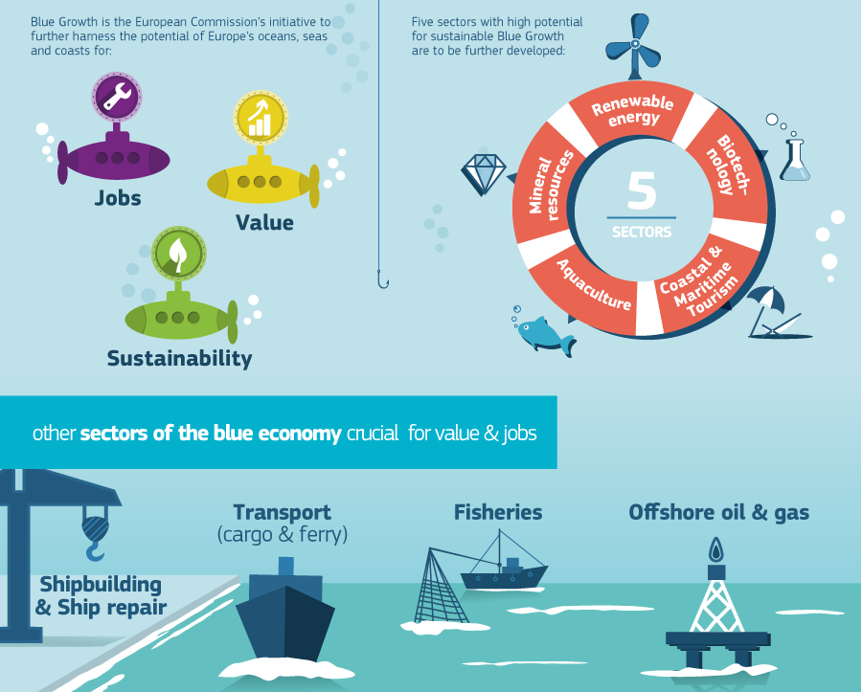

Slide 4


Communication COM(2010)352
Europe, the world’s No 1 tourist destination – a new political framework for tourism in Europe
Four Axis and 21 Actions (already implemented)
Stimulating competitiveness of the sector
Promoting the development of a sustainable, responsible, and high quality tourism
Consolidating image and profile of Europe
Maximising the potential of EU policies and financial instruments for developing tourism
EC political priorities for the 2015 and on forward
Promote more innovation and the use of new digital technologies and getting the most out of the new business models and the digital transformation
Support the creation of a skilled workforce and the mobility of the workforce, with particular regard to young trainees
Promote the internationalisation of tourism SMEs, their access to funds and their better integration into the value chain and smart specialisation specialization strategies and growing global competition also from low-cost emerging destinations.

Slide 5
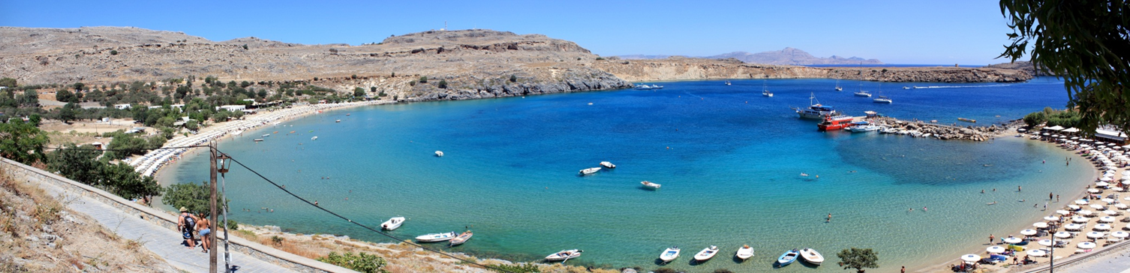
Coastal and Maritime Tourism: a European view
3,2 million people employed and 4 out of 9 nights spent in coastal areas
Increasing demand for sailing, diving, cruising…
Largest sub-sector of tourism, of marine economy
Steady growth of tourism over past decades
Gaps in data and knowledge and fragmentation
among stakeholders
Seasonality and diversification of the tourism offer
Pressure on marine environment, competition for space
Connectivity, accessibility of islands and remote destinations
Appropriate skills development and lack of innovation and adequate use of ICT…
5
Notes:
replica of Eiffel tower in Epcot or Las Vegas
Replica of Versailles in Shenzhen
…

Slide 6
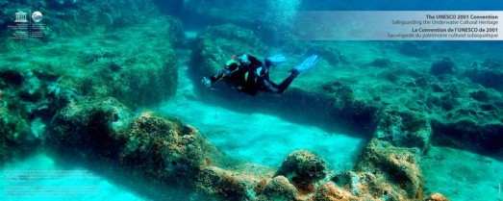
The European Strategy for more growth and jobs on Coastal and Maritime tourism
COM (2014) 86
  …to boost competitiveness and sustainability, unlock its potential for growth and jobs
  4 pillars, 14 actions at EU level, need for joint implementation:
    Stimulate performance and competitiveness
    Promoting skills and innovation
    Strengthening sustainability
    Maximize available EU funding

Slide 7
Implementation:
Key Actions have started…
Pan-European Dialogue between cruise operators, ports and coastal tourism stakeholders
  Launching conference, Bruxelles 5-6 March 2015
Smart Cooperation, transnational + inter-regional partnerships, territorial clustering, networks,
  Conference, Bruxelles 20 January 2015, and ongoing
On-going study on safety equipment for recreational boats and professional requirements for yacht skippers, to be finalized by February 2016
Promote ecotourism, sustainable tourism products, waste prevention and –management strategies

Slide 8
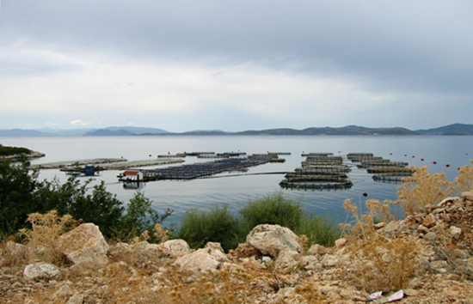
Key Actions…
Diversification (water-based sports, underwater archaeology, eno-gastronomic products, better integration of inland attractors, transnational thematic itineraries, etc.)
On-going study on innovative practices for marina development and islands connectivity, to be finalized by February 2016
Online guide to EU funding available for the sector
http://ec.europa.eu/DocsRoom/documents/7203?locale=en

Slide 9
Pan-European Dialogue on cruise
Launching conference 5-6 March 2015 in Brusselles, as an opportunity to encourage best practice sharing and agreements between cruise industry, ports and coastal tourism stakeholders for innovative approaches to cruise tourism.
3 main stakeholder groups: cruise operators, ports, destinations & coastal stakeholders
Over 200 high-level and skilled participants
Wide agreement on conference summary:
  Commitment to sustainable development of cruise, coastal and maritime tourism
  Involve whole tourism value chain in benefits and deliveries
  Guarantee well-being of coastal and insular populations
  Contribute to social and economic coastal development

Slide 10
The stakeholders regional dialogue on cruise
The first regional dialogue between cruise tourism stakeholder will take place on 14 October 2015 in Olbia, Sardinia, Italy, in parallel with the General Assembly of Medcruise.
The event will take the format of an operational working group and therefore there will be a limited number of participants from the three stakeholders group, namely cruise operators, ports and destinations of the Mediterranean.
It aims at delivering concrete outcomes, to be continuously developed in the future and it can represent a model to be replicated in other sea basins areas, such as Baltic, Atlantic, North Sea.
The issue of promotion of the inland (rural area as well), (action 11 of the CMT Strategy encourage the diversification and integration of coastal and inland attractors, including through thematic itineraries like cultural, religious or ancient trade routes)

Slide 11
The revised EUSBR Action Plan ¨[10.09.15] in line with the implementation of the CMT
The Policy Area- PA : Tourism- reinforcing cohesiveness of the macro-region through tourism
Overall aim of policy area 'Tourism': develop the Baltic Sea Region as a common tourism destination. Coastal and maritime plays a significant role.
Challenges on tourism in the Baltic sea Regions:
Fragmentation and non-cooperative approaches
lacks of a comprehensive institutional and political framework.
On going actions/ flagships
Facilitate networking and clustering of tourism stakeholders;
Cruise ship,facilitate sustainable shore excursions of cruise ship operators in the Baltic Sea
Establisment of a Baltic Sea Tourism Centre (BSCT) in 2016 as a self-sustainable governance structure, which will be focused on the implementation of strategic and operational activites
Rural and coastal tourism

Slide 12
Synergies between EUSBR Action Plan and CMT Strategy
Action 1- EUSBR Action Plan: Facilitate networking and clustering of tourism stakeholders (Flagship projects)
Action 4 – MCT Strategy: Support the development of trans-national and interregional partnership, networks, clusters and smart specialisation strategies.
Conference in Brusseles, January 2015: Smart Cooperation in Coastal and maritime tourism through Networks and Clusters
Clusters Theme- and objective-driven industrial networks that aim at the common development of products, services and processes/ link different projects across industrial sector boundaries!).
Cooperation between neighbouring individual attractions determined by complementarities
Action 2 EUSBR Action Plan-Mobilise the full potential for sustainable tourism of the Baltic Sea region (flagship projects)
Action 8 MCT Strategy– Promote ecotourism, using the EMAS, Ecolabel and the European Tourism Indicator System- ETIS
During the 2 ETIS pilot testing phases, some destinations from Finland, Estonia, Poland, Germany , Lithuania and Latvia have been involved.

Slide 13
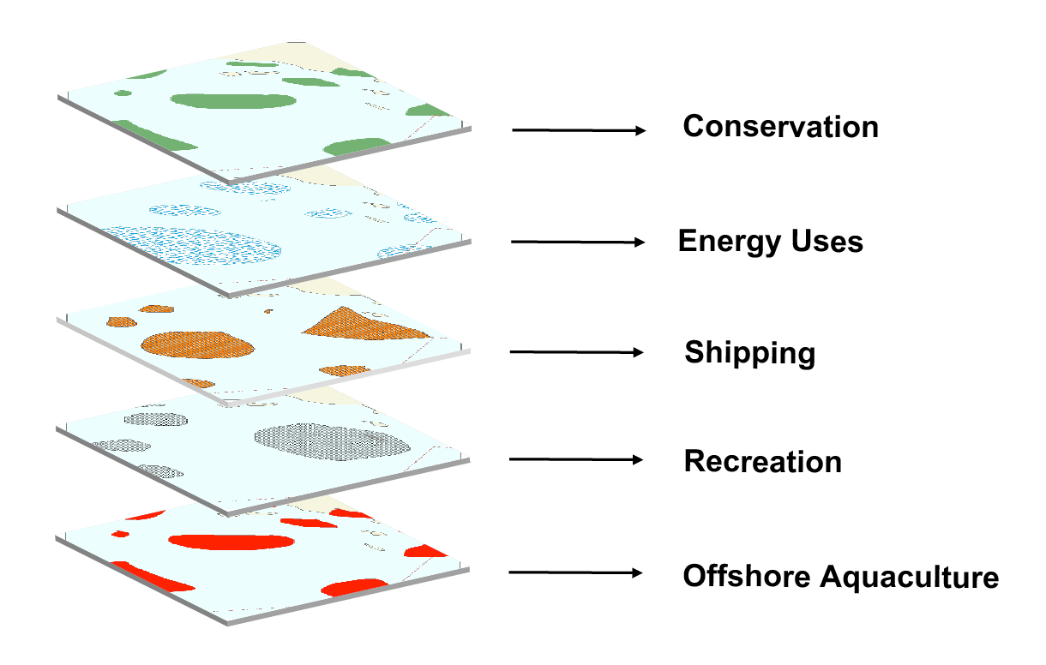
The Maritime Spatial Planning
Directive 2014/89/EU

Slide 14
Maritime Spatial Planning
Benefits related to the tourism sector and link with EUSBR Horizontal Action
Member States, through their maritime spatial plans, shall contribute to the sustainable development and growth in the marine sector, including the promotion of sustainable tourism.
The MS shall transpose the Directive into force in their laws, by 18 September 2016 and the MSO shall be established and implemented at the latest by 31 March 2021.
Cooperation among Member States: as part of the planning and management process, MS bordering marine waters shall cooperate with the aim of ensuring that marine spatial plans are coherent and coordinated across the marine regions concerned.
The good example of VASAB Tallin Declaration (Vision and Strategies around the Baltic Sea), in the context of the HELCOM (Baltic Marine Environment protection Commission) Action Plan, to develop and integrated MSP process in the Baltic Sea Region countries

Slide 15
The European Institutional networks (1)
Enterprise Europe Network (EEN)
The new EEN network established in the framework of the COSME programme will be operational from 2015-2021.
A Call for Proposals has been published in mid-January 2014 with a total budget of 336 M€ for 2015-2021. Gathering currently 54 countries, 600 organisations and 3000 experts, it aims at becoming a “one-stop shop” for the European SMEs providing integrated support services to help SMEs that seek to explore business opportunities.
The Enterprise Europe Network Sector groups are a focal point for stimulating cross-border business and technology cooperation between SMEs in their sectors, and across sectors. This also includes organizing sectorial Business to Business events and company missions.
The sector groups are also expected to explore and put in place synergies between their own practical advisory and partnership services for SMEs and relevant EU policy initiatives.
The main Enterprise Europe Network Sector group relevant to the tourism sector is the Tourism and Cultural Heritage Sector Group.
The network also provides feedback to the Commission on problems and issues encountered by SMEs, which is then fed into the analysis for preparing new measures and proposals affecting this target group.
EEN - http://een.ec.europa.eu/

Slide 16
The European Institutional networks (2)
European Network for Rural Development (ENRD)
ENRD was set up by DG AGRI in 2008 to help Member States implement the 94 Rural Development Programmes (RDPs). It serves as a platform for the sharing of ideas and experience on rural development policies. Its main stakeholders include National Rural Networks, national authorities, Local Action Groups and rural development organisations. It highlights examples of successful rural development projects across the EU, promotes transnational cooperation and provides analysis of relevant themes including economic diversification and rural tourism.
ENRD - https://enrd.ec.europa.eu/en/splash
European Fisheries Areas Network (FARNET)
This network brings together all fisheries areas supported by Union Priority 4 of the European Maritime and Fisheries Fund (EMFF). It aims to assist the different stakeholders involved in the sustainable development of fisheries areas at local, regional, national and European level. Over the last programming period, the core of the network reached over 300 Fisheries Local Action Groups (FLAGs). These public-private partnerships set up at local level, work towards the sustainable development of their areas through a strategy which is designed by themselves. Based in 21 Member States, these FLAGs manage a budget to support a range of projects proposed and carried out by a wide variety of local stakeholders.
FARNET - https://webgate.ec.europa.eu/fpfis/cms/farnet/ ; (Conference brochure "Sailing Towards 2020": https://webgate.ec.europa.eu/fpfis/cms/farnet/files/documents/Farnet_Brochure2020_EN_WEB.compressed.pdf

Slide 17
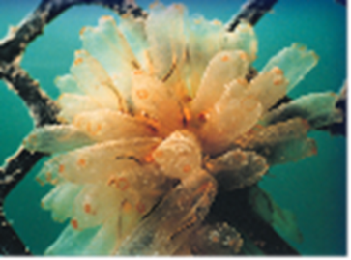
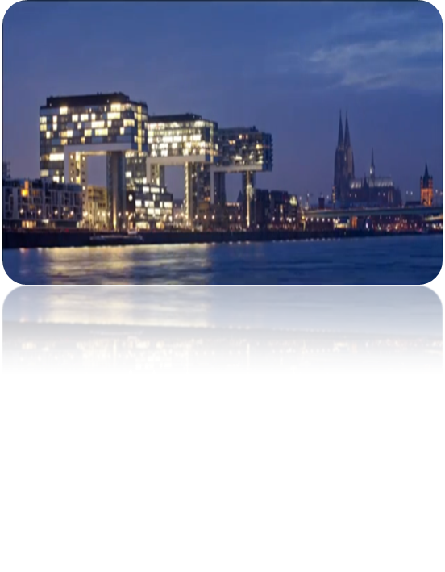
Funding – ESIF 2014-2020
European Maritime Fisheries Fund - EMFF:
→ to help fishermen and sector in transition, support coastal communities in diversifying their economies
→ to improve quality of life along European coasts
→ to make best use of fishermen's knowledge, experience, use this potential in Blue Growth areas such as tourism;
→ To capitalise on environmental assets, develop tourism-related project, such as eco-tourism, pesca-tourism, accommodation, tourist trails, diving; address "diversification", professional trainings, life-long learning,new professional skills
European regional development fund-ERDF
  →11 thematic objectives
      → No tourism as a priority
Relevance for tourism: R&I; ICT investments; SME competitiveness; Low-Carbon economy; Employment and labour mobility; education, skills and lifelong learning

Slide 18
Call for proposals on underwater cultural heritage
To be published in October 2015
The total budget earmarked for the co-financing of projects amounts € 195.000
(1 or 2 projects maximum)
General objectives :
  Support the extension of the tourism season, hence contributing to improve SME's competitiveness and jobs growth;
  Foster synergies between tourism and cultural related activities and the local impact on economy and people;
  Foster transnational cooperation among various actors along the tourism value chain with regard to underwater cultural heritage;
  Encourage diversification of the supply of European sustainable and cultural tourism products and services by the development of sustainable transnational underwater cultural heritage thematic tourism products;
  Better market uptake and visibility of attractive sustainable European transnational underwater cultural heritage tourism offer;
  Better valorisation of the European natural and cultural underwater heritage and of its potential for the further development of the tourism sector.
Eligible activities:
  1. Design and develop a transnational cultural underwater heritage tourism product.
  2. Run a pilot test to validate the transnational underwater heritage tourism product concept.
  3. Measure and evaluate the test's results and gather the lessons learned.

Slide 19
Underwater cultural heritage workshop
Brussels 1 October 2015
At the High-level Conference of EU Ministers of Tourism, held in March 2014 in Athens, this submerged heritage has moreover been recognized as important for the diversification of coastal and maritime tourism, one of the priorities in current tourism development
To increase awareness of the topic and facilitate knowledge exchange among experts, researchers and decision makers, an European Parliament – UNESCO information meeting.

Slide 20
Funding- Cosme programme 2014-2020
EU programme for competitiveness and SMEs; € 2,3 bn
→Four priorities:

Slide 21
COSME PROGRAMME 2016 provisional activites for tourism
3 Operational objectives
Diversifying and increasing the tourism offer;
Creating conditions for a favourable and competitive environment for tourism business;
Increasing Europe's visibility as a tourist destination and supporting tourism-related business to find international business partners in target markets
Call for proposals and call for tender (aprox 3.100,000 euro)
Increasing Europe's visbility as a tourist destination- Supporting toruism –related business to find international business partners in target markets
Publication of the call – Q2 2016

Slide 22
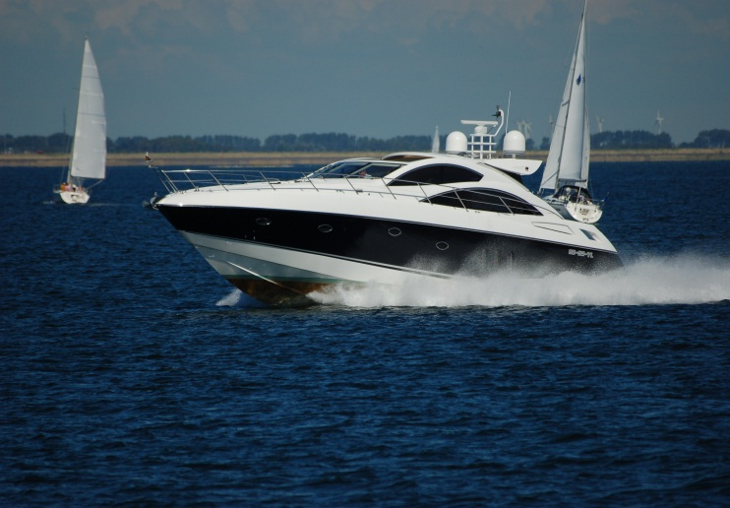
Conclusions
A lot of actions undertaken in the framework of EUSBR Action Plan, can be further supported by the CMT Strategy
All actors to play their role in integrated approach
Good examples of progress (actions, projects, initiatives, events)
Commission continues to support and enable stakeholders
ESIF, MFF, COSME and long-term strategies and financial policy under way
Combined effort is important, stakeholder, network and cluster-driven!

Slide 23

Contact details
DG GROWTH
Unit F4 Tourism, creative and cultural industry
GROW-F4@ec.europa.eu
Thank you for your attention!

