Slide 1

8th Baltic Sea Tourism Forum 2015 – Gdańsk, 22-23.09
The role of meetings and events industry in the development of Gdansk tourism
Łukasz Wysocki
President of Gdańsk Tourist Organization

Slide 2

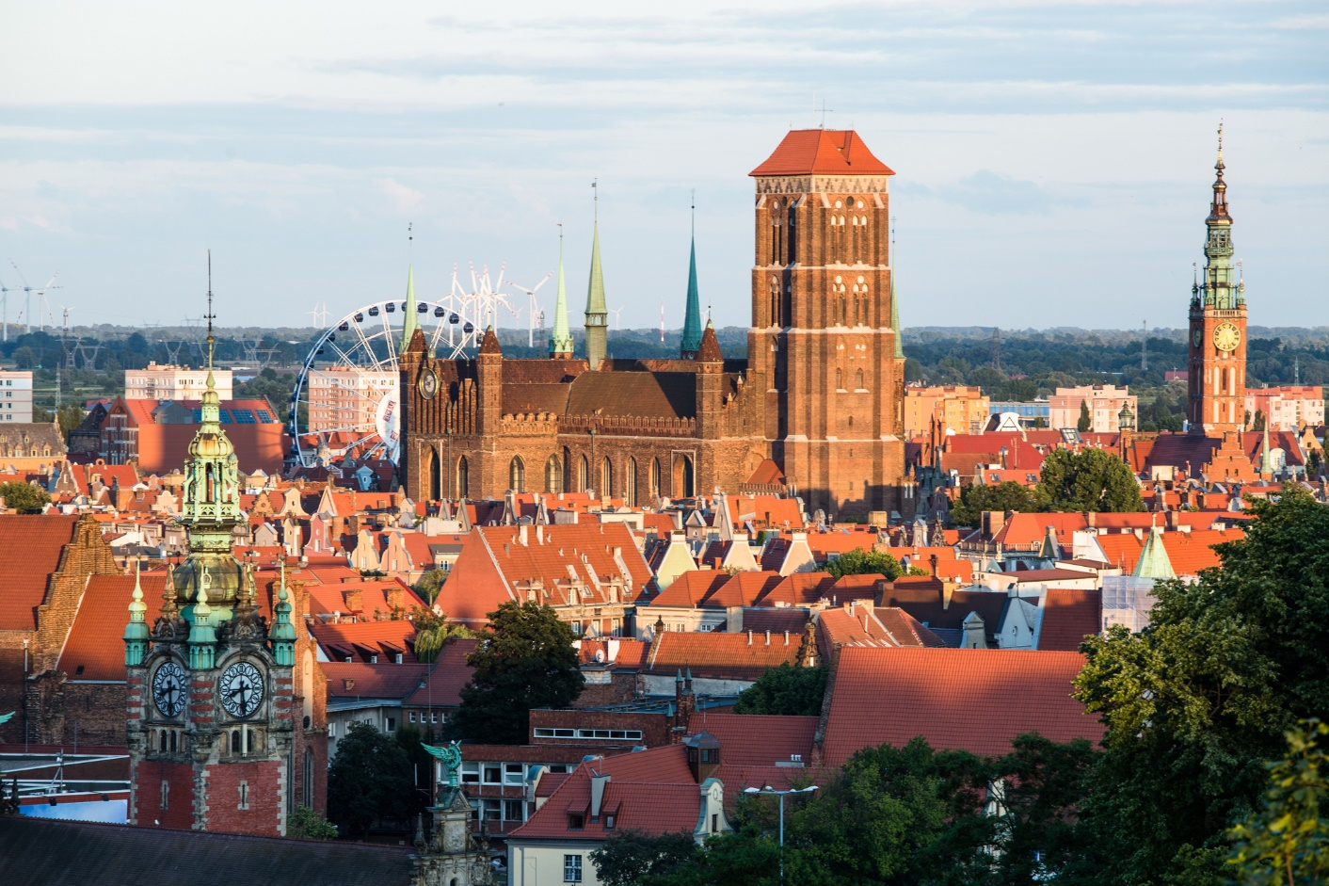
The role of meetings and events industry in the development of Gdansk tourism
Tourism in Gdańsk

Slide 3
The role of meetings and events industry in the development of Gdansk tourism
2009 – 4th place
2010/11 – 3rd place
2013 – 2nd place
2014 – 5th place
Ranking of business destinations
*According to the Poland Convenion Bureau

Slide 4
The role of meetings and events industry in the development of Gdansk tourism
Business investments in Gdańsk

Slide 5
The role of meetings and events industry in the development of Gdansk tourism
Infrastructure
Lech Walesa Airport
Port of Gdańsk

Slide 6
The role of meetings and events industry in the development of Gdansk tourism
Conference facilities in Gdańsk
42 hotels with conference facilities
73 unique venues
5 exhibition/
congress centres
5 higher education institutions

Slide 7
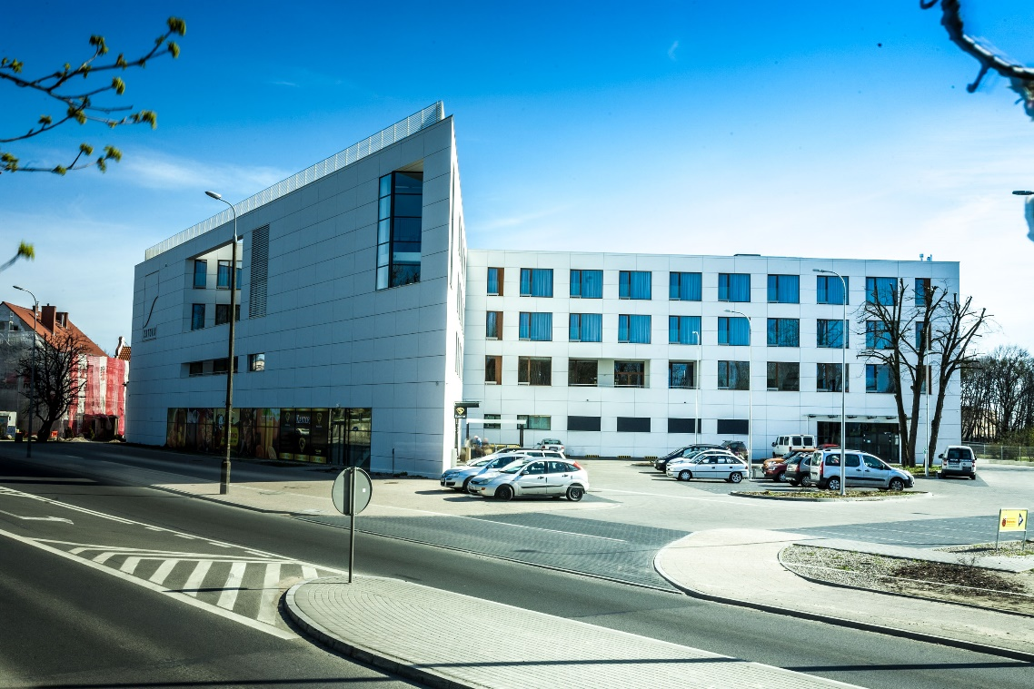
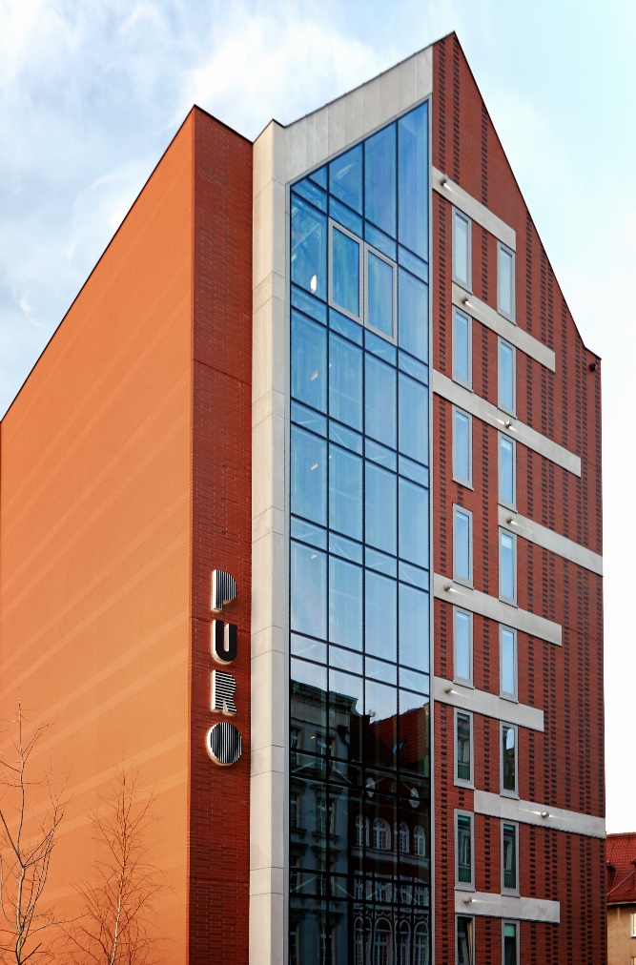
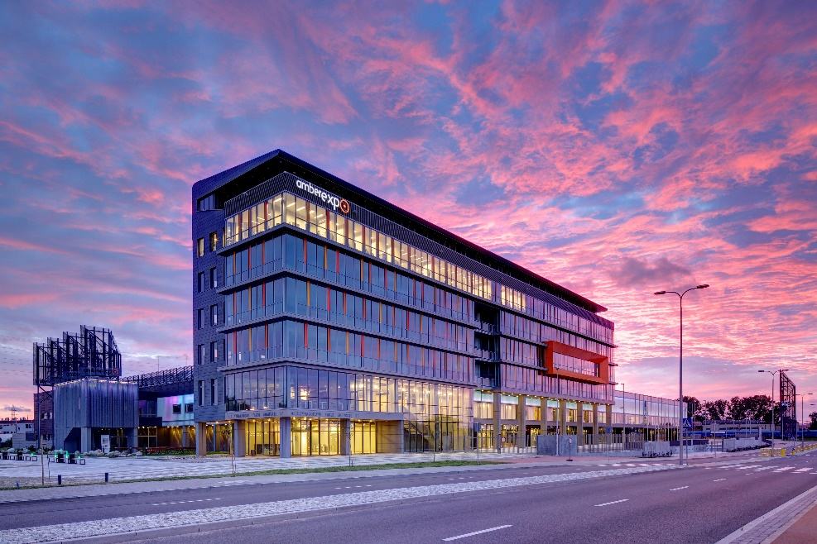
The role of meetings and events industry in the development of Gdansk tourism
New hotels & conference facilities

Slide 8
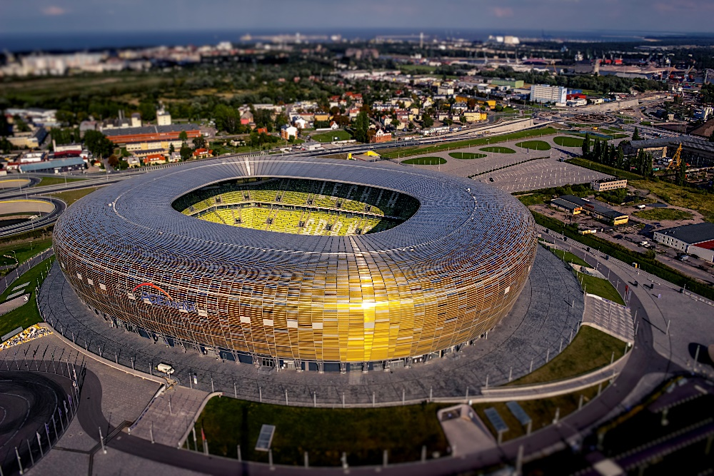
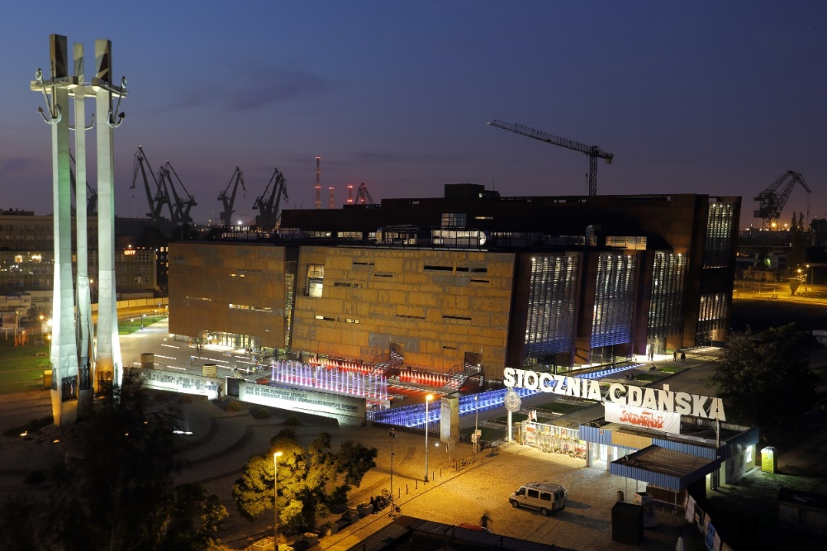
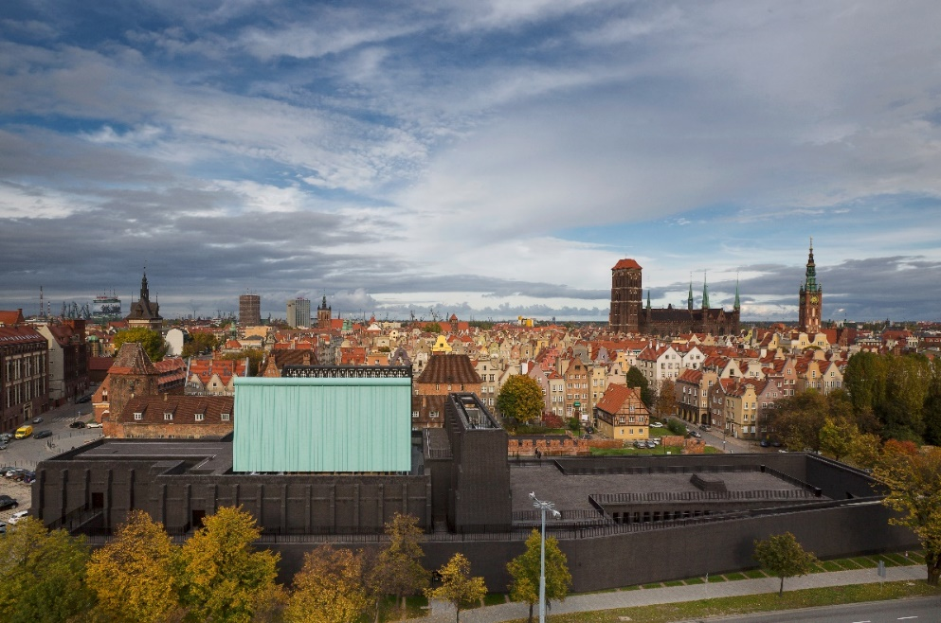
The role of meetings and events industry in the development of Gdansk tourism
Unique venues

Slide 9
The role of meetings and events industry in the development of Gdansk tourism
Seasonality of tourism in Gdańsk in 2014

Slide 10
The role of meetings and events industry in the development of Gdansk tourism
Work opportunities in tourism in Gdańsk

Slide 11
The role of meetings and events industry in the development of Gdansk tourism
Meetings industry in Gdańsk in 2014
2 423 business events
288 786 participants

Slide 12
The role of meetings and events industry in the development of Gdansk tourism
Meetings industry in Gdańsk in 2014

Slide 13

The role of meetings and events industry in the development of Gdansk tourism
Business tourist - profile
Travels by:
Train (40%)
Car (35%)
Plane (20%)
He is between 25 and 54 years old
Is well educated
Has his own company or does intellectual work
Stays in 3* to 5* hotels
Spends on average 650 zl/day

Slide 14



The role of meetings and events industry in the development of Gdansk tourism
Entertainment and cultural events
Entertainment events, such as concerts, tend to draw in a younger crowd, which is reflected in the profile of its participant, who:
is between 18 and 34 years of age
does intellectual work or studies
is well educated
travels by car or train

Slide 15
The role of meetings and events industry in the development of Gdansk tourism
Meetings and events industry in Gdańsk
Growing permanent employment in the tourist industry
Increase in the appeal outside of the summer season
Investments in the business infrastructure
Better quality of service

Slide 16
The role of meetings and events industry in the development of Gdansk tourism
Thank you for your attention
Łukasz Wysocki
President of Gdańsk Tourist Organization

